Slide 1
Object Detection with YOLOv4
Shanq-Jang Ruan, Ph. D.
Distinguished Professor
Dept. Electronic and Computer Engineering
National Taiwan University of Science and Technology

Slide 2
Outline
The YOLOv4 Architecture
CSPDarknet53
Spatial Pyramid Pooling (SPP)
Path Aggregation Network (PANet)
How does the YOLO model work?
Implementation
Tiny YOLOv4
YOLOv4 on Edge TPU
Conclusion

Slide 3
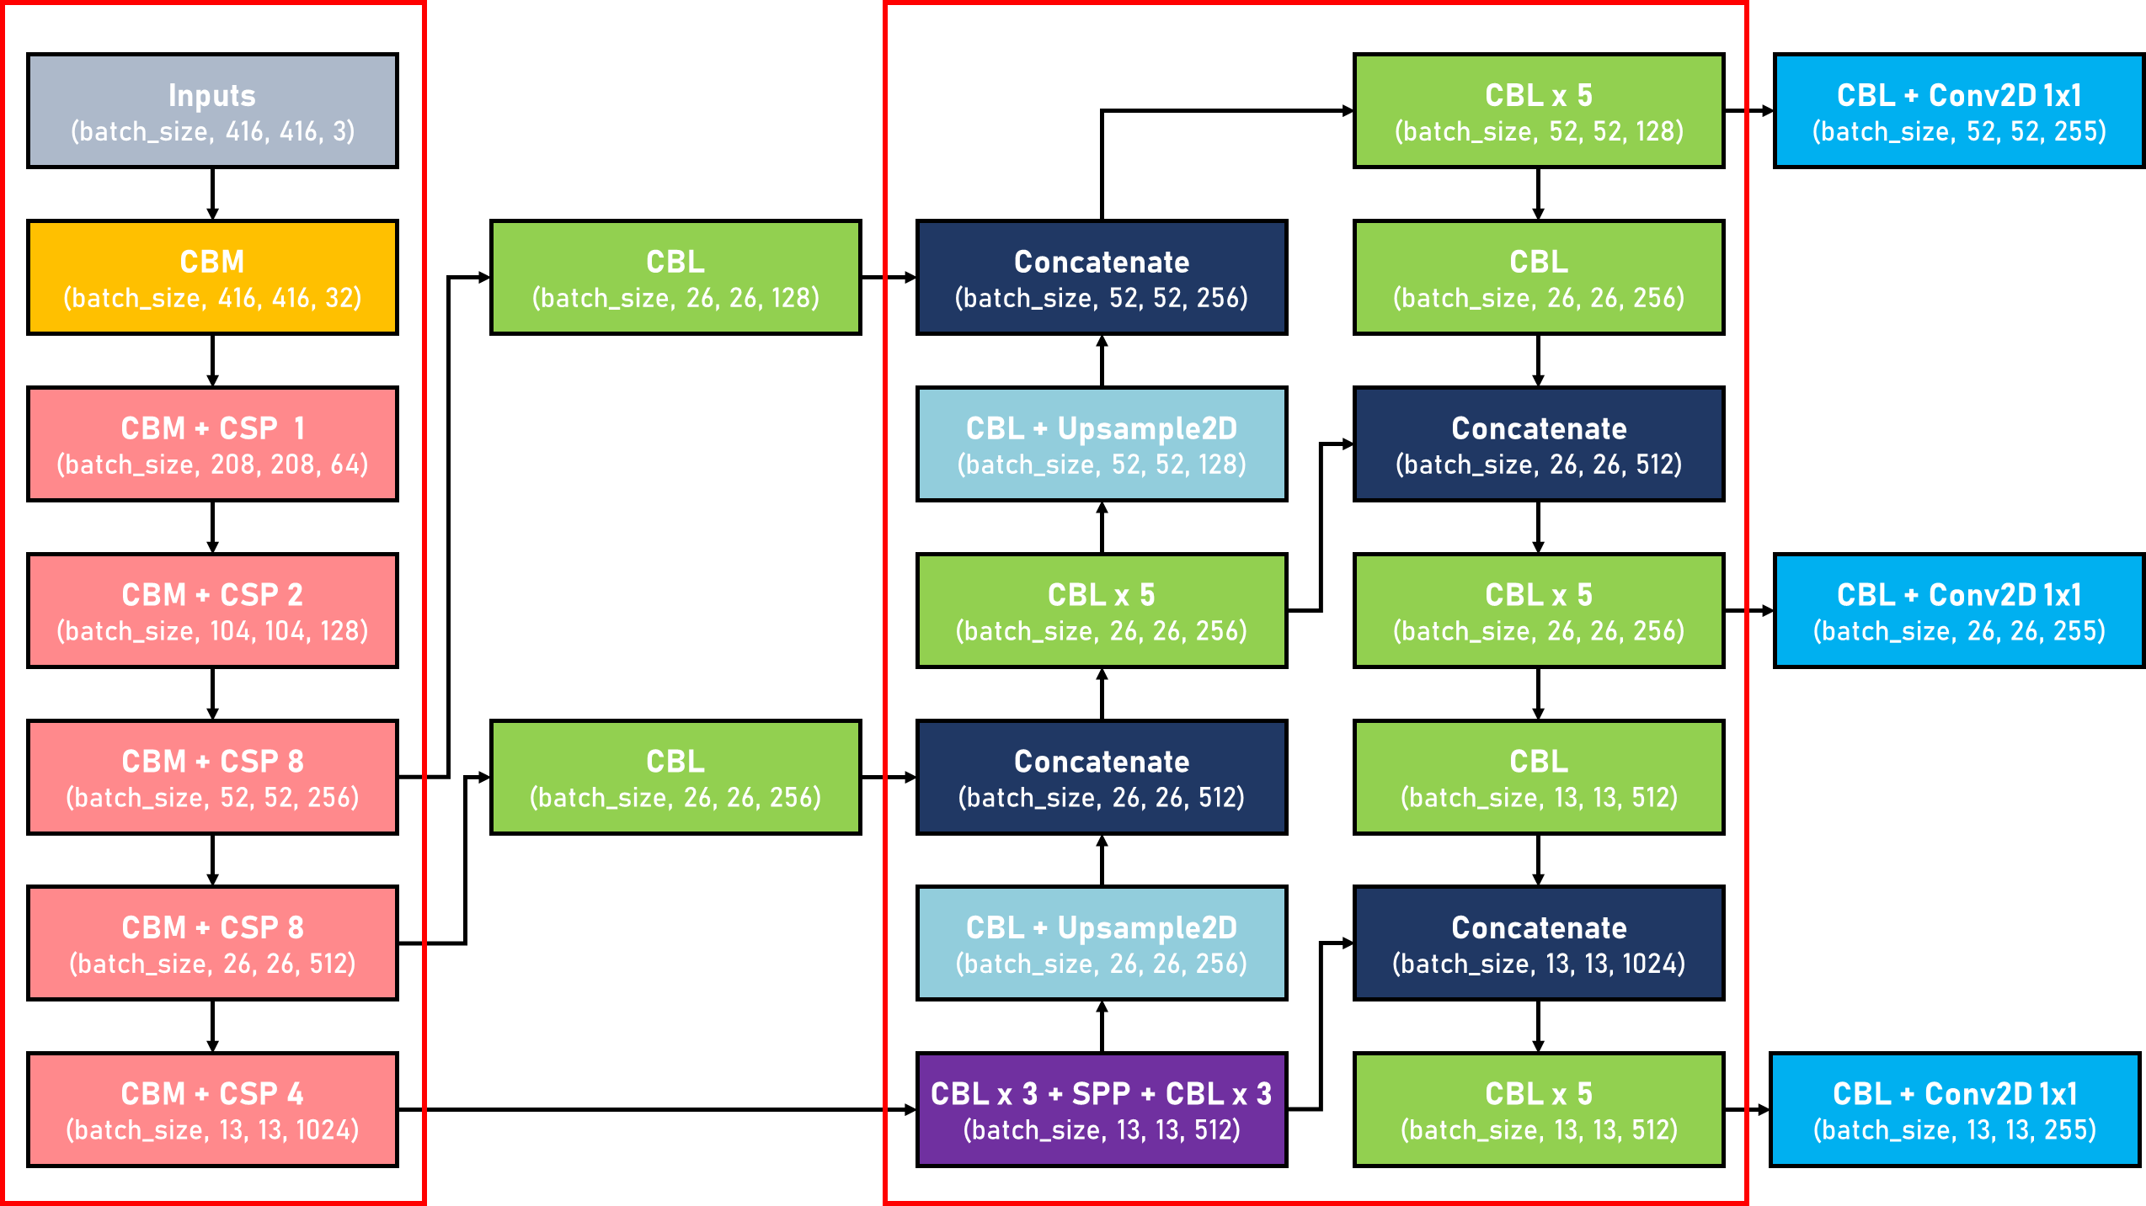
Model Architecture
CSPDarknet53
PANet
CBM
: Convolution + Batch Normalization + Mish
CBL
: Convolution + Batch Normalization + Leaky ReLU

Slide 4
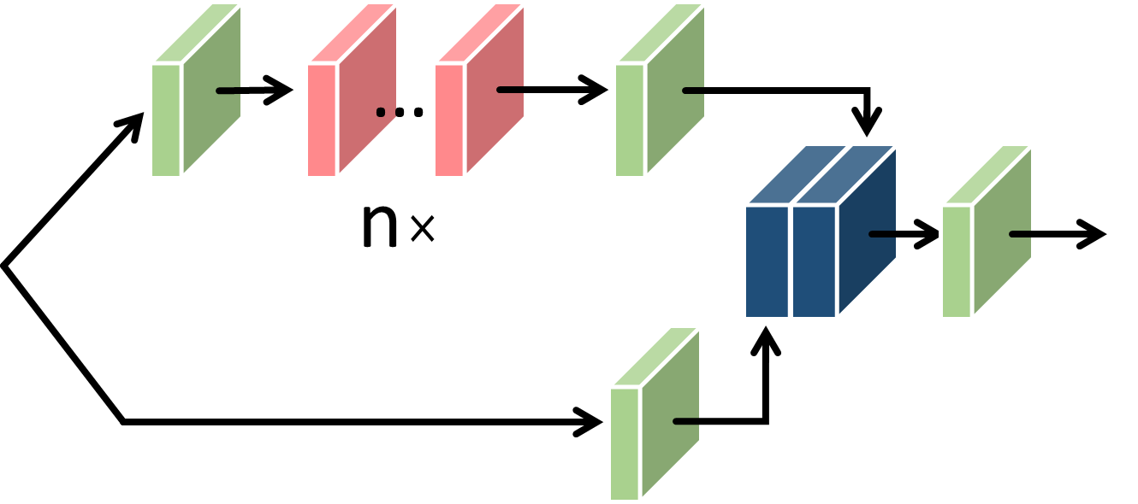
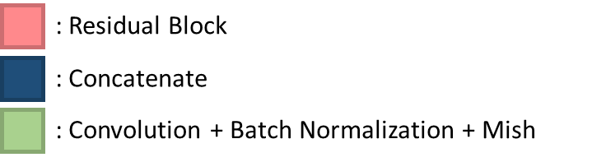
CSPDarknet53
Cross Stage Partial (CSP)
能夠在降低20%計算量的情況下保持甚至提高CNN的能力

Slide 5
CSPDarknet53
Cross Stage Partial Network (CSPNet)
從網絡結構設計的角度來解決以往工作在推理過程中需要很大計算量的問題。
作者認爲推理計算過高的問題是由於網絡優化中的梯度信息重複導致的。
CSPNet通過將梯度的變化從頭到尾地集成到特徵圖中，在減少了計算量的同時可以保證準確率。CSPNet是一種處理的思想，可以和ResNet、ResNeXt和DenseNet結合。
Cross Stage Partial (CSP)
Strengthening the learning ability of a CNN.
Removing the computational bottlenecks.
Reducing the memory costs.

Slide 6
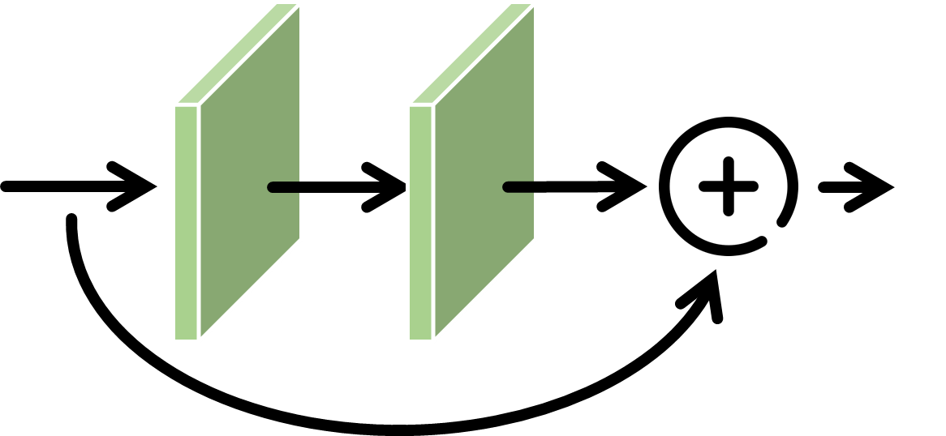
CSPDarknet53
Residual Block
有一個捷徑連結。這個捷徑連結會跳過一層線性轉換和非線性輸出，直接成為上兩層中 activation function 的輸入，因為這個捷徑連結，對來源層的輸出，提供了一個等同於 identity transform 或作直接拷貝的連結到非相鄰的目標層，減少了一層的轉換，所以又被稱為 skip connection。
捷徑連結

Slide 7
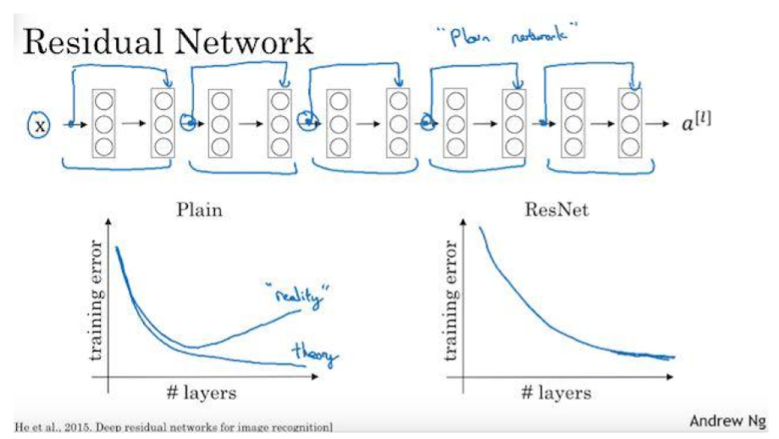
Residual Blocks
可以發現擁有 Residual Blocks 的 Residual Network 在 training error 的表現會逐漸降低 training error （下圖右）而沒有如 plain network 的 training degradation 問題（下圖左，略呈拋物線的曲線，標註為 reality）。

Slide 8
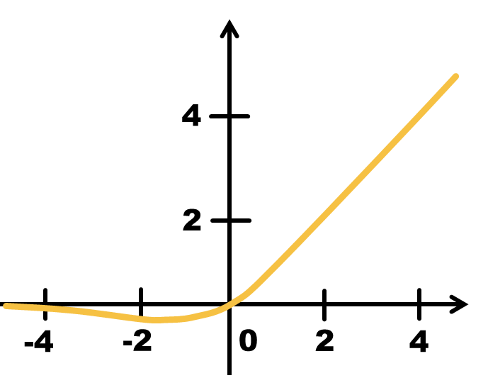
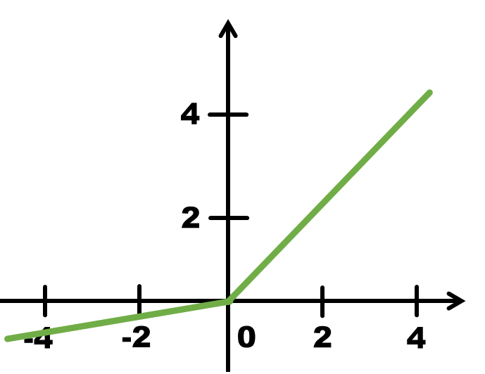
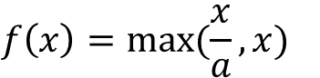
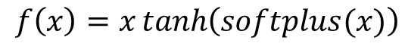
Activation Function
Owing to the smoothness of Mish, it provides better generalization and effective optimization to improve the quality of the results.
$$f\left(x\right)=x\tanh\left(softplus(x)\right)$$
$$f\left(x\right)=max⁡(\frac{x}{a},x)$$
(a) Mish function
(b) Leaky ReLU

Slide 9
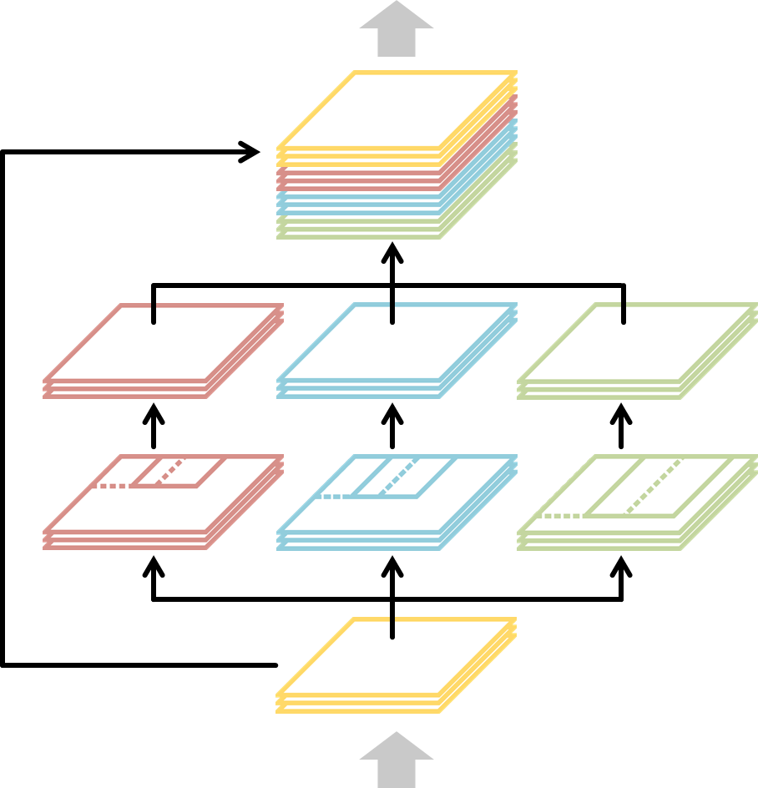
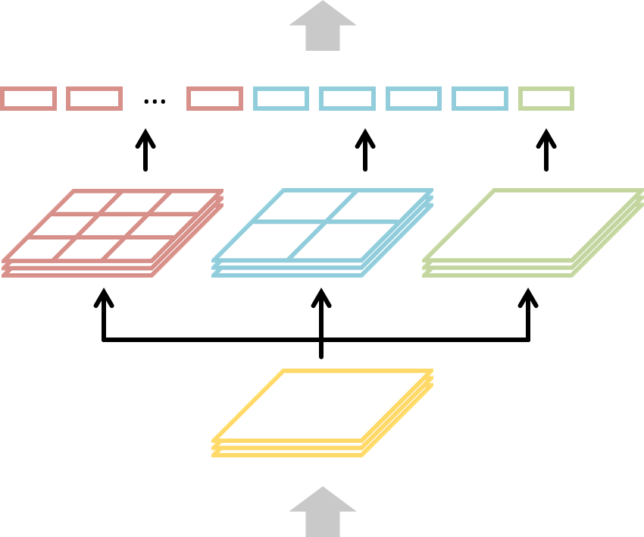
Spatial Pyramid Pooling (SPP)
是一個處理multi-scale和multi-size靈活的方法，增加CNN的魯棒性，提升分類效果。
Output Feature
Output Feature
Concatenate
Max Pooling
Zero padding
Stride = 1
Input Feature
Input Feature
(a) Spatial Pyramid Pooling
(b) Improved Spatial Pyramid Pooling

Slide 10
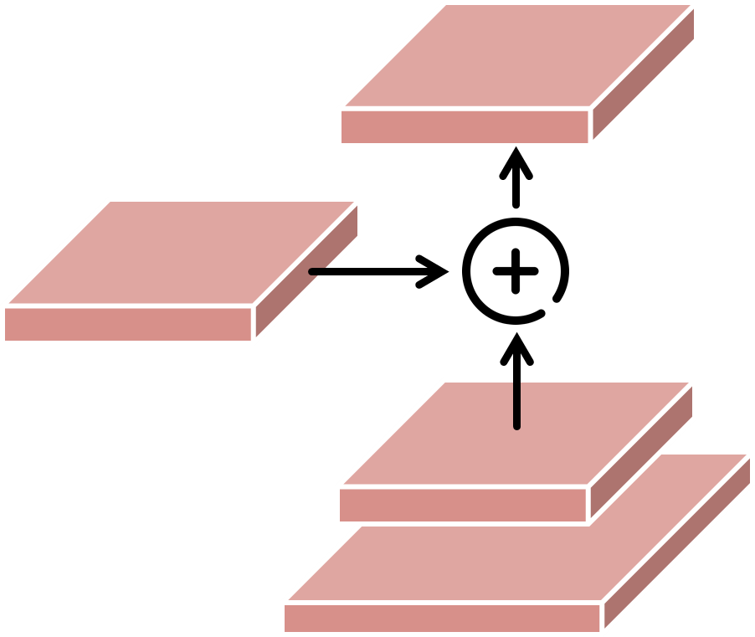
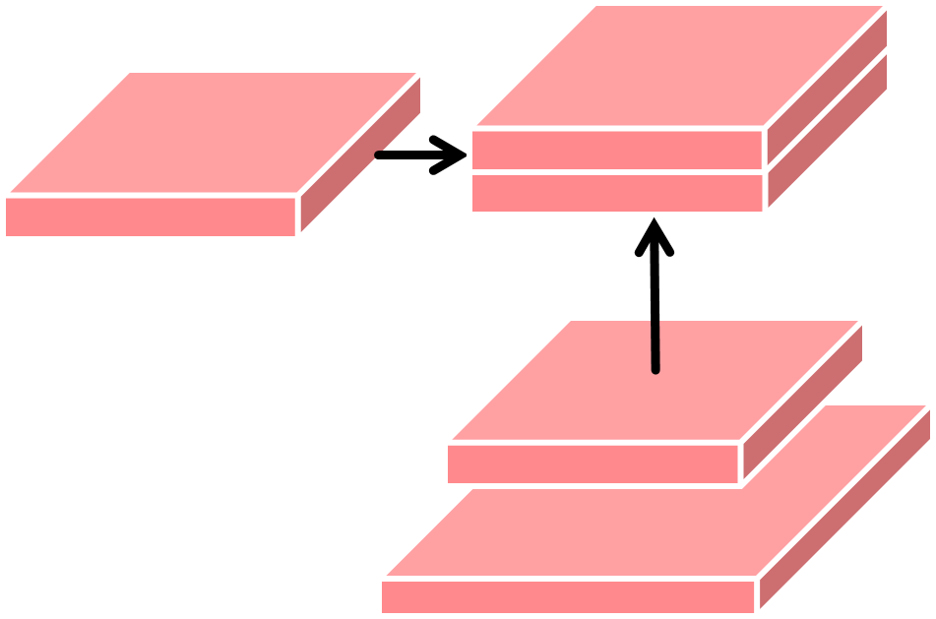
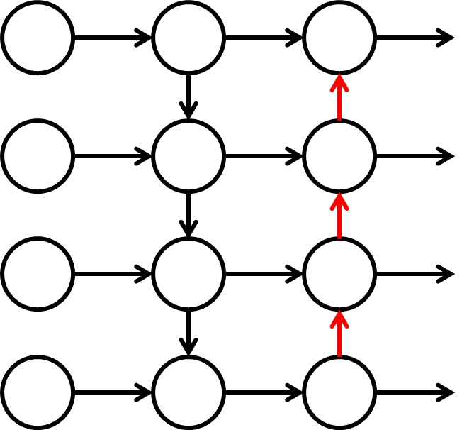
Path Aggregation Network (PANet)
Bottom-up path augmentation is adopted to preserve the low-level features when the layers become deeper.
通過自底向上的路徑，我們用低層精確的定位信號來增強整個特征層次結構，從而縮短了低層與頂層之間的信息路徑。
(a) PANet
(b) Modified PANet

Slide 11
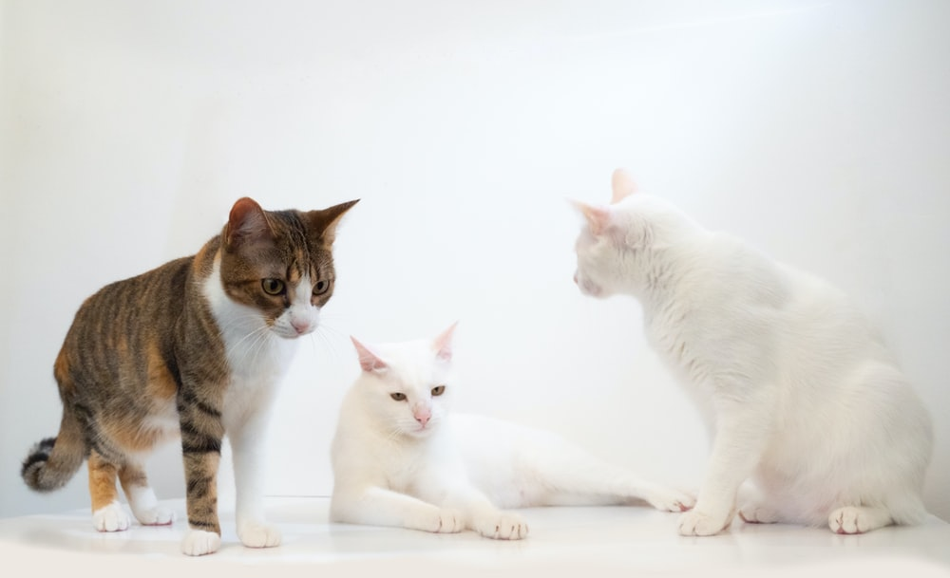
How does the YOLO model work?
Grid cell
Bounding Box Prior
(The anchors in different phases of scale prediction)
Midpoint

Slide 12
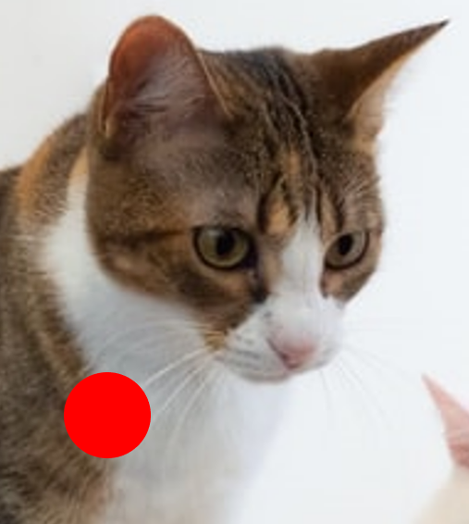
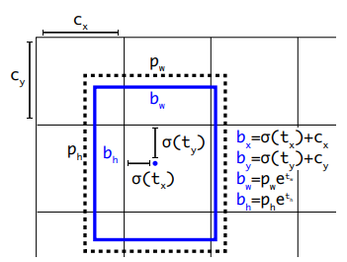
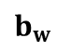
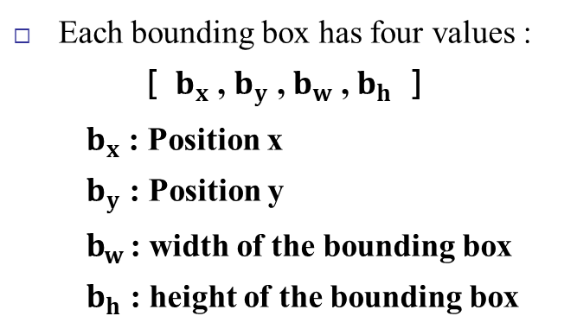
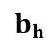
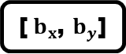
How does the YOLO model work?
$$b_{w}$$
Each bounding box has four values :
［ $b_{x}$ , $b_{y}$ , $b_{w}$ , $b_{h}$ ］
$b_{x}$ : Position x
$b_{y}$ : Position y
$b_{w}$ : width of the bounding box
$b_{h}$ : height of the bounding box
1
1
$$b_{h}$$
[${ b}_{x}$, $b_{y}$]
Grid cell
Can be larger than 1 if the object is wider than an entire cell.

Slide 13
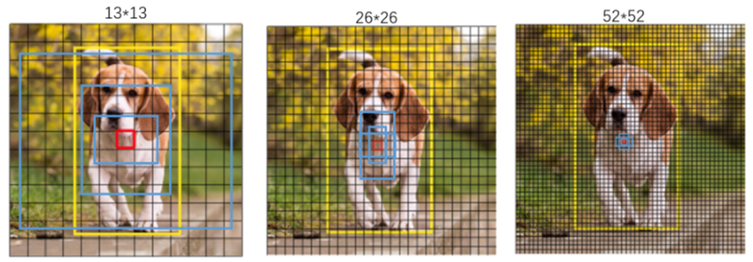
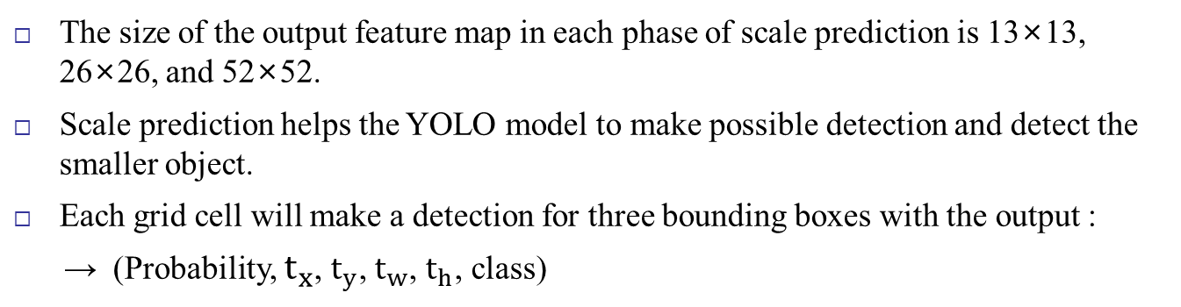
Scale Prediction
The size of the output feature map in each phase of scale prediction is 13×13, 26×26, and 52×52.
Scale prediction helps the YOLO model to make possible detection and detect the smaller object.
Each grid cell will make a detection for three bounding boxes with the output :
→ (Probability, $t_{x}$, $t_{y}$, $t_{w}$, $t_{h}$, class)
Phase 1 Phase 2 Phase 3
(13x13) (26x26) (52x52)
Total predictions = (13×13 + 26×26 + 52×52) × 3 × ( 5 + class ) = 266,175 predictions

Slide 14
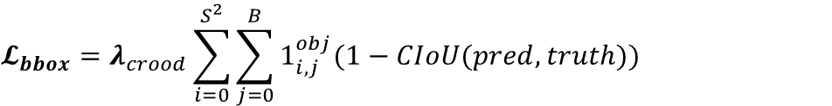
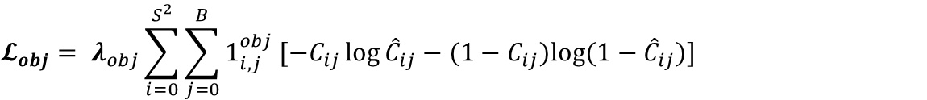
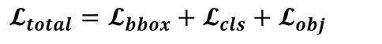
Loss Function
$$𝓛_{bbox}=λ_{crood}\sum_{i=0}^{S^{2}}{\sum_{j=0}^{B}{1_{i,j}^{obj}(1−CIoU(pred,truth))}}$$
CIoU-loss
$$𝓛_{obj}= λ_{obj}\sum_{i=0}^{S^{2}}{\sum_{j=0}^{B}{1_{i,j}^{obj}}}[−C_{ij}\log{{\hat{C}}_{ij}}−(1−C_{ij})log(1−{\hat{C}}_{ij})]$$
Cross-entropy Loss
$$𝓛_{cls}= λ_{class}\sum_{i=0}^{S^{2}}{\sum_{j=0}^{B}{1_{i,j}^{obj}\sum_{cεclasses}{[−p_{i}\left(c\right)\log{{\hat{p}}_{i}\left(c\right)}−(1−p_{i}\left(c\right))\log{{(1−\hat{p}}_{i}\left(c\right))}]}}}$$
$$𝓛_{total}=𝓛_{bbox}+𝓛_{cls}+𝓛_{obj}$$
S = Scale Prediction Size → 13×13, 26×26, 52×52

Slide 15
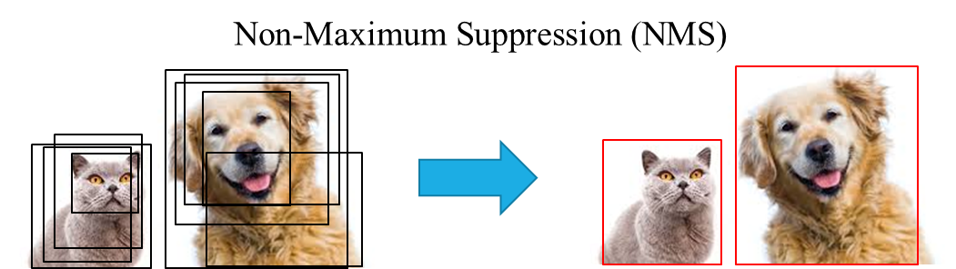
Non-Maximum Suppression (NMS)
有可能一個物件被很多候選框給選到，下左圖假設算法抓到這麼多框都是物件，這時候要怎麼處理，用Non-Maximum Suppression的方法去消除多餘物件框找到最佳的框，

Slide 16
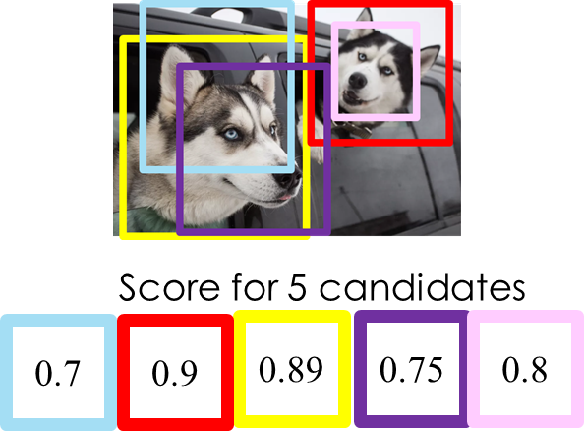
Algorithm
先看哪個BBox的信心程度最高，那個BBox會進去「確定是物件集合」(途中的selected objects)內
其他BBox和剛選出來的BBox算IoU，然後算出來的IoU大於設定好的閾值的BBox，那些BBox的信心度會被設定為0(也就是這個BBox重複計算要刪掉)。

Slide 17
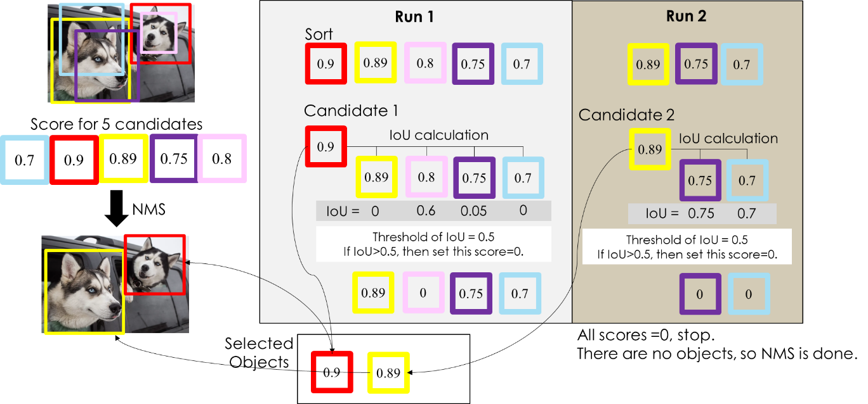
https://chih-sheng-huang821.medium.com/%E6%A9%9F%E5%99%A8-%E6%B7%B1%E5%BA%A6%E5%AD%B8%E7%BF%92-%E7%89%A9%E4%BB%B6%E5%81%B5%E6%B8%AC-non-maximum-suppression-nms-aa70c45adffa

Slide 18
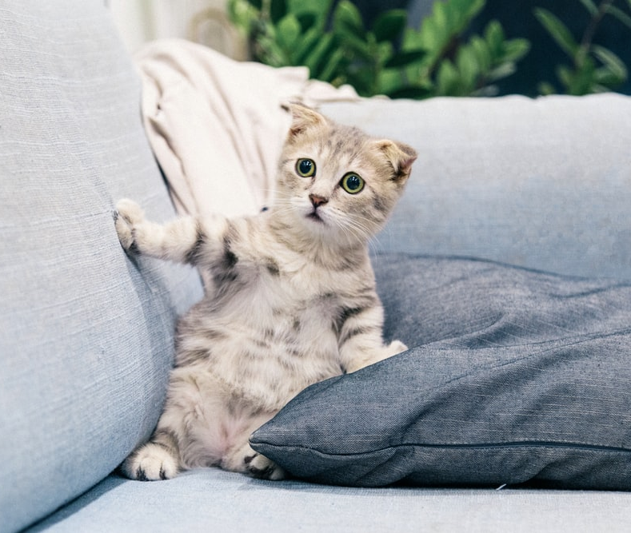
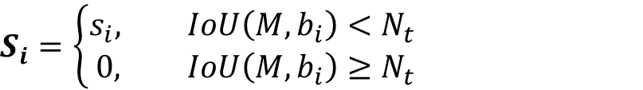
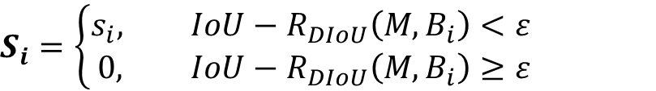
Non-Maximum Suppression (NMS)
cat
cat
cat
cat
cat
NMS
$$S_{i}=\left\{\begin{aligned}s_{i}&, IoU\left(M,b_{i}\right)<N_{t} \\ 0&, IoU\left(M,b_{i}\right)≥N_{t}\end{aligned}\right.$$
DIoU-NMS
$$S_{i}=\left\{\begin{aligned}s_{i}&, IoU−R_{DIoU}\left(M,B_{i}\right)<ε \\ 0&, {IoU−R}_{DIoU}\left(M,B_{i}\right)≥ε\end{aligned}\right.$$

Slide 19
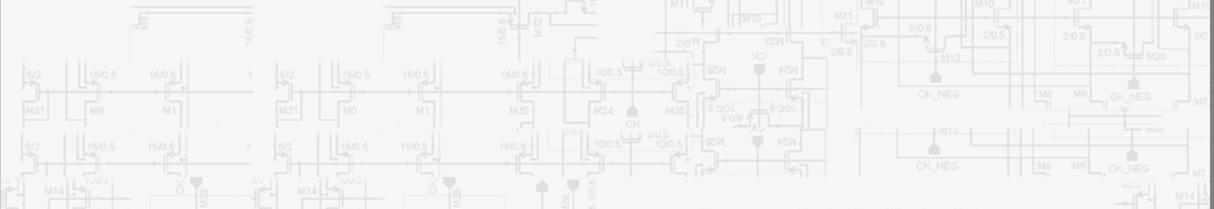
Implementation

Slide 20
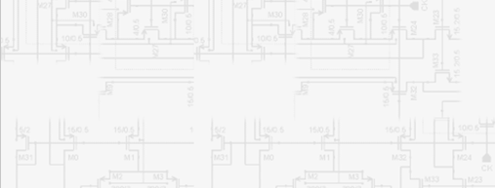

Raspberry Pi

Slide 21
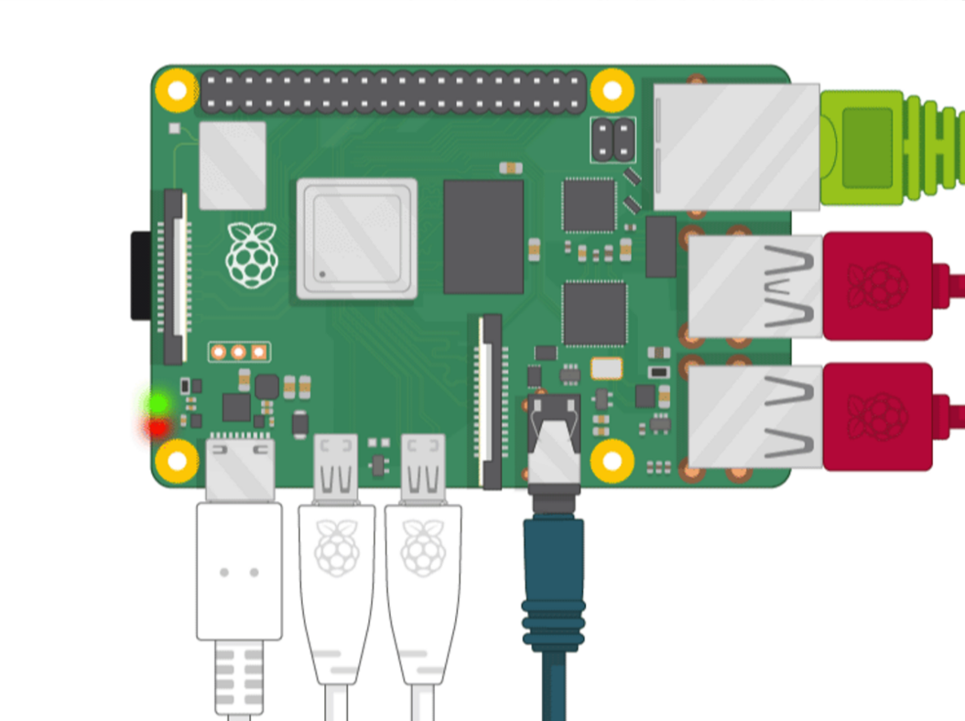
Raspberry Pi
The Raspberry Pi is a tiny computer that runs Linux.
It employs SoCs, which combine the CPU and GPU onto a single integrated circuit, with the RAM, USB ports, and other components soldered to the board.
RJ45
SD card
USB3 port
USB2 port
Audio cable
Type C
Micro HDMI

Slide 22
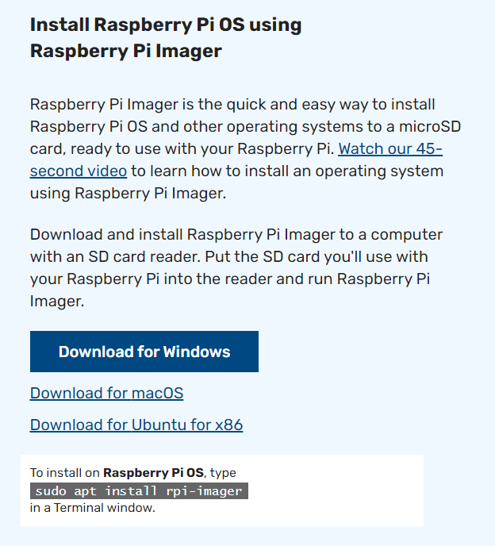
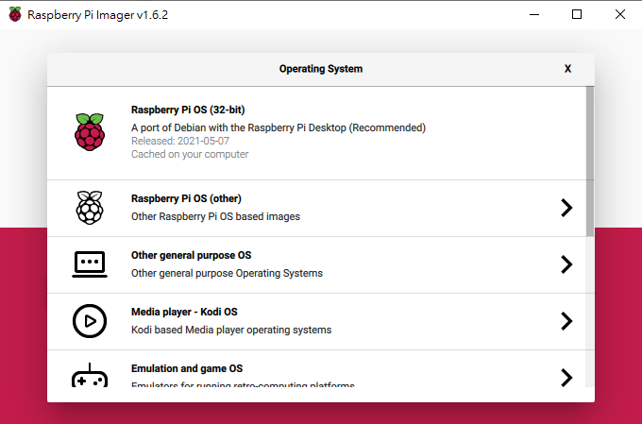
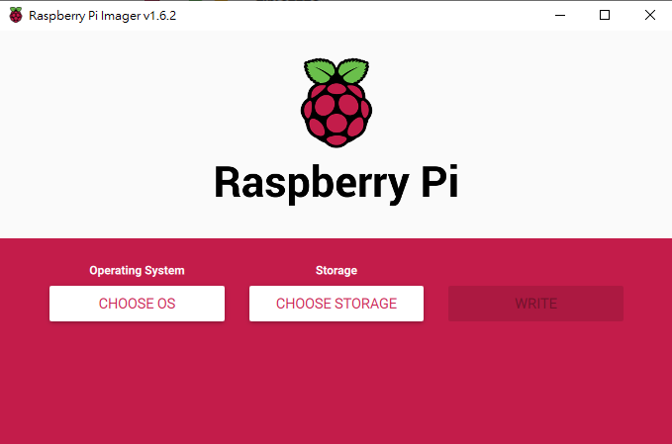

Raspberry Pi
Raspberry Pi set up:
Install OS: Raspberry Pi downloads page (Bullseye 64-bit)
Step 1: Select the Raspberry Pi Imager which matches your OS
Step 2: Launch Raspberry Pi Imager and choose your settings
Step 3: Press “WRITE” to write image to the SD cards

Slide 23
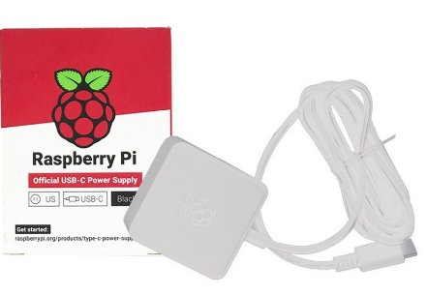

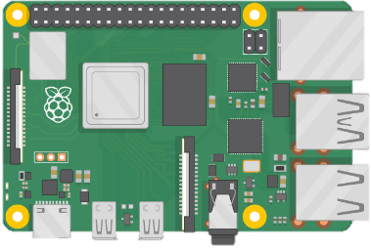


Raspberry Pi
Raspberry Pi set up:
Power
Webcam
Raspberry Pi
Monitor
Keyboard & Mouse

Slide 24
Raspberry Pi
Install Packages:
# upgrade the tools
$> pip3 install --upgrade pip
$> sudo apt-get -y update
$> pip3 install --upgrade setuptools
# install TensorFlow
$> pip3 install tensorflow-2.8.0-cp39-cp39-linux_aarch64.whl wrapt --upgrade
--ignore-installed
# keras
$> pip3 install keras==2.8.0
# opencv
$> pip3 install opencv-contrib-python
$> pip install protobuf==3.20.*

Slide 25
YOLOv4 with TensorFlow 2
Installation
Download pre-trained weights
https://drive.google.com/drive/folders/1Xbvy4wbeXMmskQCJuFraAK71RanBq0Nb?usp=sharing
Dependencies
1 python3 -m pip install yolov4
1 python3 -m pip install opencv-python
1 python3 -m pip install tensorflow

Slide 26
YOLOv4 with TensorFlow 2
Inference
# Using YOLOv4 to detect ‘kite.jpg’.
$> cd /home/lpslab/Desktop/lab1/CPU
$> python3 yolo_v4.py
1 import cv2
2 from yolov4.tf import YOLOv4 3 4 yolo = YOLOv4() 5 6 yolo.config.parse_names("coco.names")
7 yolo.config.parse_cfg("./config/yolov4.cfg")
8 9 yolo.make_model()
10 yolo.load_weights(“./weight/yolov4.weights", weights_type="yolo")
11 yolo.summary() 12
13 # Image 14 yolo.inference(media_path=“kite.jpg")

Slide 27
YOLOv4 with TensorFlow 2
Dataset
COCO Dataset 2017 Train images
COCO Dataset 2017 Val images
train2017.txt/val2017.txt
1 <path>/image_0.jpg <class_id>,<center_x>,<center_y>,<width>,<height> ... 2 <path>/image_1.jpg <class_id>,<center_x>,<center_y>,<width>,<height> ... 3 <path>/image_2.jpg <class_id>,<center_x>,<center_y>,<width>,<height> ... 4
5 ...

Slide 28
YOLOv4 with TensorFlow 2
Training
Google Colab
TF: v2.8.0
YOLOv4: v3.2.0
COCO 2017 Dataset

Slide 29
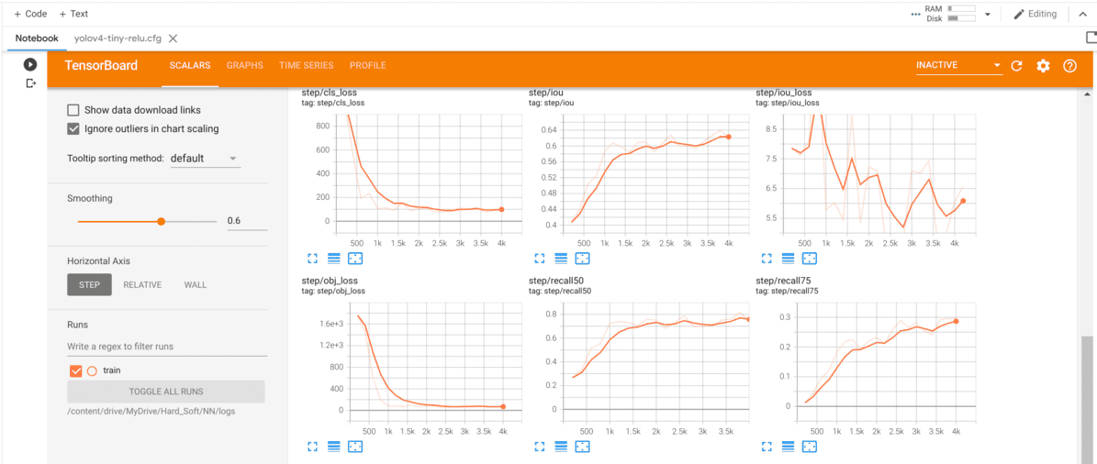
YOLOv4 with TensorFlow 2
TensorBoard
1 tensorboard --logdir logs

Slide 30
Tiny YOLOv4

Slide 31
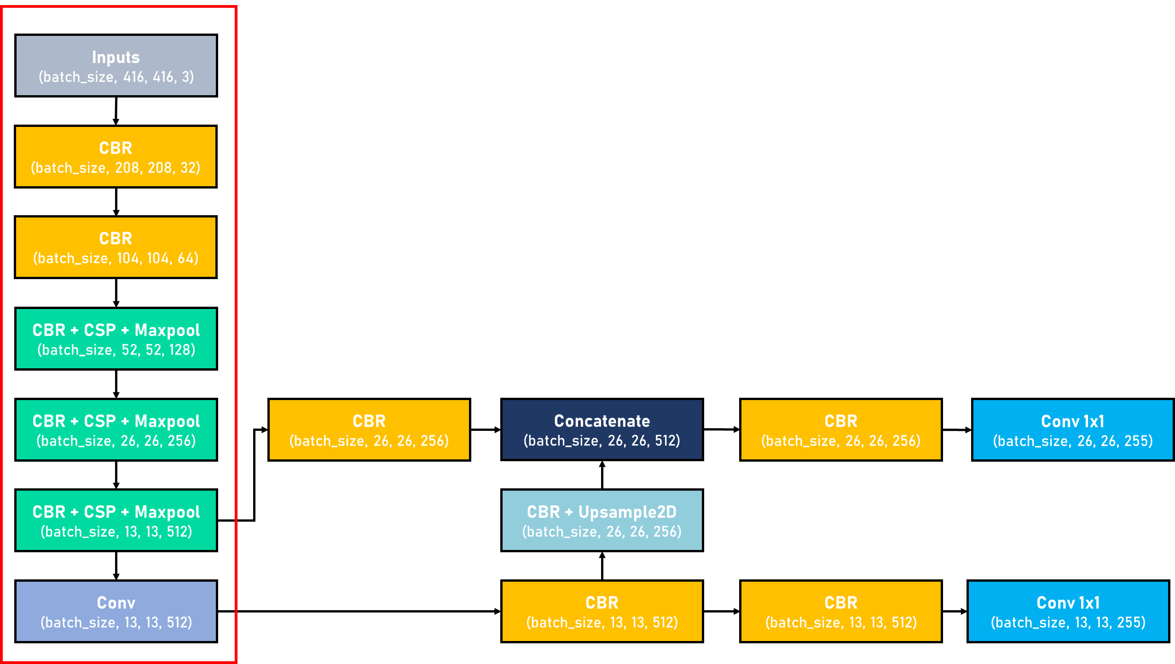
Tiny YOLOv4
Tiny CSPDarknet
CBR
: Convolution + Batch Normalization + ReLU

Slide 32
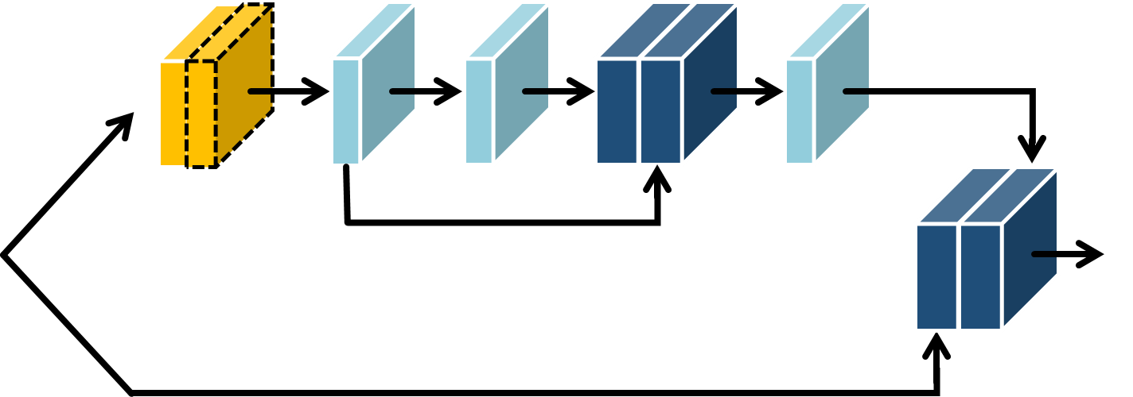
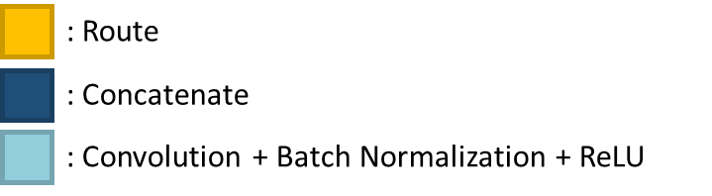
Tiny CSPDarknet
Cross Stage Partial (CSP)

Slide 33
Performance
The following table compares the different methods in FPS and mAP.
Method
YOLOv3
YOLOv4
YOLOv3-tiny
YOLOv4-tiny
FPS
49
41
270
294
mAP(%)
52.5
64.9
38.1
38.0

Slide 34
Implementation

Slide 35



Slide 36
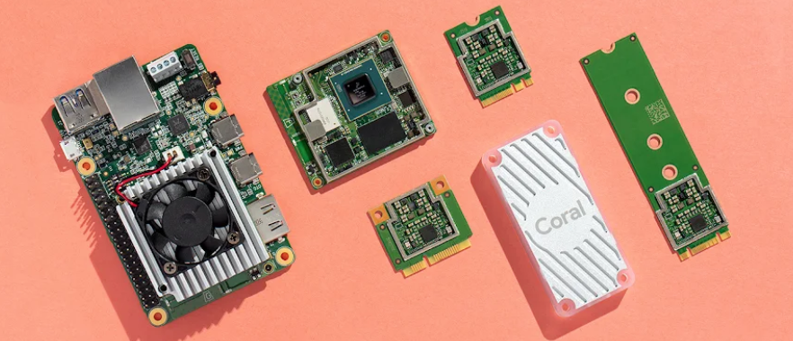
Google Coral
Coral is a complete toolkit to build products with local AI.
Coral USB Accelerator
The Coral USB Accelerator adds an Edge TPU coprocessor to your system, enabling high-speed machine learning inferencing on a wide range of systems, simply by connecting it to a USB port.

Slide 37
Google Coral
What is the Edge TPU?
The Edge TPU is a small ASIC designed by Google that provides high performance ML inferencing for low-power devices.
What is the Edge TPU's processing speed?
An individual Edge TPU can perform 4 trillion (fixed-point) operations per second (4 TOPS), using only 2 watts of power.
How is the Edge TPU different from Cloud TPUs?
Cloud TPUs run in a Google data center, and therefore offer very high computational speeds. Whereas, the Edge TPU is designed for small, low-power devices to speed up model inferencing.

Slide 38
YOLOv4 on Edge TPU
Compared to YOLOv4, Tiny YOLOv4 is more suitable for implementation with its smaller size.
Tiny YOLOv4 uses Leaky ReLU while it is an unsupported operation on edge TPU. To address this issue, ReLU is used for the activation function.

Slide 39
YOLOv4 on Edge TPU
Convert to tflite
1 from yolov4.tf import YOLOv4, YOLODataset, save_as_tflite 2 3 yolo = YOLOv4() 4 5 yolo.config.parse_names("data/classes/coco.names") 6 yolo.config.parse_cfg("config/yolov4-tiny-relu-tpu.cfg") 7 8 yolo.make_model() 9 yolo.load_weights("weights/yolov4-tiny-relu.weights", weights_type="yolo") 10 11 dataset = YOLODataset(config=yolo.config, 12 dataset_list="data/dataset/val2017.txt", 13 image_path_prefix="data/dataset/images/val2017", 14 training=False 15 ) 16 save_as_tflite(model=yolo.model, 17 tflite_path="model/yolov4-tiny-relu-int8.tflite", 18 quantization="full_int8", 19 dataset=dataset 20 )

Slide 40
YOLOv4 on Edge TPU
Install the Edge TPU runtime
Add Debian package repository to your system
Install the Edge TPU runtime
Connect the Coral USB Accelerator to the computer using the provided USB 3.0 cable.
echo "deb https://packages.cloud.google.com/apt coral-edgetpu-stable main" | sudo tee /etc/apt/sources.list.d/coral-edgetpu.list
curl https://packages.cloud.google.com/apt/doc/apt-key.gpg | sudo apt-key add –
sudo apt-get update
sudo apt-get install libedgetpu1-std

Slide 41
YOLOv4 on Edge TPU
Edge TPU Compiler
Download the compiler on your Linux system
Compile the TensorFlow Lite model (.tflite file) into a file that's compatible with the Edge TPU.
curl https://packages.cloud.google.com/apt/doc/apt-key.gpg | sudo apt-key add –
echo "deb https://packages.cloud.google.com/apt coral-edgetpu-stable main" | sudo tee /etc/apt/sources.list.d/coral-edgetpu.list
sudo apt-get update
sudo apt-get install edgetpu-compiler
edgetpu_compiler model/yolov4-tiny-relu-int8.tflite

Slide 42
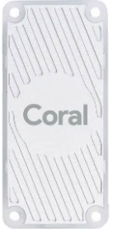


Google Coral
Coral set up:
Google
Coral
USB Accelerator
Power
(USB 3.0)
Webcam
Raspberry Pi
Monitor
Keyboard & Mouse

Slide 43
YOLOv4 on Edge TPU
Run the example script
# Using tiny-YOLOv4 without edge TPU to detect streaming.
$> cd /home/lpslab/Desktop/lab1/TPU
$> python3 yolov4_tiny_video_test.py
# Using tiny-YOLOv4 with edge TPU to detect streaming.
$> python3 edge_yolov4_tiny_video_test.py
~
11 yolo.load_tflite("./weight/yolov4-tiny-relu-int8_edgetpu.tflite")
~ 18 yolo.inference(
19 "/dev/video1",
20 is_image=False,
21 cv_apiPreference=cv2.CAP_V4L2,
22 cv_frame_size=(640, 480), 23 cv_fourcc="YUYV" 24 )

Slide 44
Conclusion
YOLOv4
An efficient model which achieves high speed and accuracy.
Tiny YOLOv4
Make the network structure simpler and reduce parameters to make it feasible for mobile and embedded devices.
Edge TPU
Enable high-speed machine learning inferencing.

